Slide 1
The Struggles of Serving God
John 15:18-21, Acts 26:9-11, 1 Corinthians 1:20-25

Slide 2
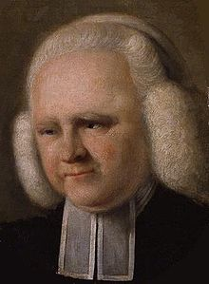
George Whitefield 1714-1770

Slide 3
In his search for God before his conversion, Whitefield fasted to the point that he broke his health and, under doctor’s orders, was confined to bed for seven weeks.
Whitefield preached at both Harvard and New Haven College (Yale). At Harvard it was reported that “The College is entirely changed. The students are full of God.” Yet Harvard’s leading professors later wrote a pamphlet denouncing Whitefield.
John Wesley is known as founder of the Methodist movement, but Whitefield formed a Methodist society first. In fact, Whitefield pioneered most methods used in the 1700s’ evangelical awakenings: preaching in fields rather than churches, publishing a magazine, and holding conferences.
Whitefield became close friends with Benjamin Franklin. Franklin once estimated that Whitefield, without any amplification, could be heard by more than 30,000 people.
In his lifetime, Whitefield preached at least 18,000 times. He addressed perhaps 10,000,000 hearers.

